Slide 1
STUS Task Management Application

Slide 2
Team Members and Roles
Frontend:
Taofeek Ojewande
Samson Agbo
Naja'atu Umar
Smith Mebawondu

Slide 3
Project Description
The main goal of this pitch is to develop a user-friendly task management app for “personal use”. A user accesses the app via a web address and either signup (if a new user) or login (an existing user) on the homepage. This directs the user to the “user dashboard” where tasks can be added, updated, read, or deleted. The tasks can be filtered based on status such as “Active, Completed”. A notification panel to show upcoming events will also be incorporated.

Slide 4
Learning Objectives
Team Collaboration: Using Version Control such as Git and GitHub.
Applications of skills taught in the ALX program most especially during the Front-end specialization phase. This includes building interactive UIs with React, implementing state management using React Hooks or Context API, handling component lifecycle and routing with React Router, and creating responsive and user-friendly interfaces using CSS frameworks or custom styles
Learning of other needed skills: Simulating backend interactions with mock APIs using tools like json-server or services like Firebase
Actualizing a project within a timeframe.
Project Management Skills
Database design
Software testing and quality assurance

Slide 5
Technology and Architecture
1. Canva
2. React.js
3. Webpack
4. Babel
5. HTML
6. CSS
7. Aphrodite
8. Firebase (for auth and data storage)
9. JSON-server (REST API)

Slide 6
Challenges Encounter
1. Simulating a backend for authentication and CRUD operations.
2. Completion of the project within 27 days.
3. Designing a visually appealing UI.
4. Testing and Validation
5. User acceptance and adoption
6. User Interface Complexity
7. Data management to store Task
8. Handling end users sensitive data

Slide 7
Third Party Services
1. Firebase
2. Browser Notifications API for reminders

Slide 8
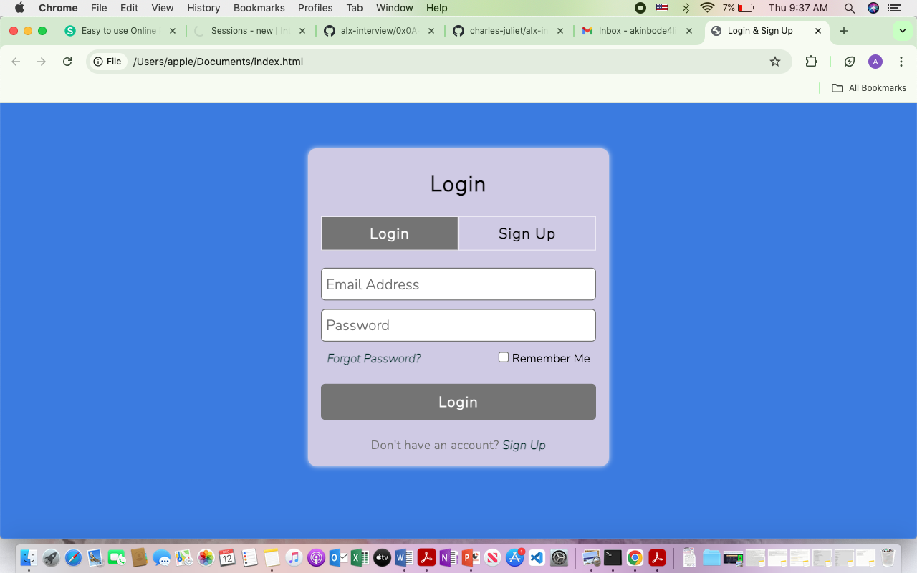
Mock Ups:

Slide 9
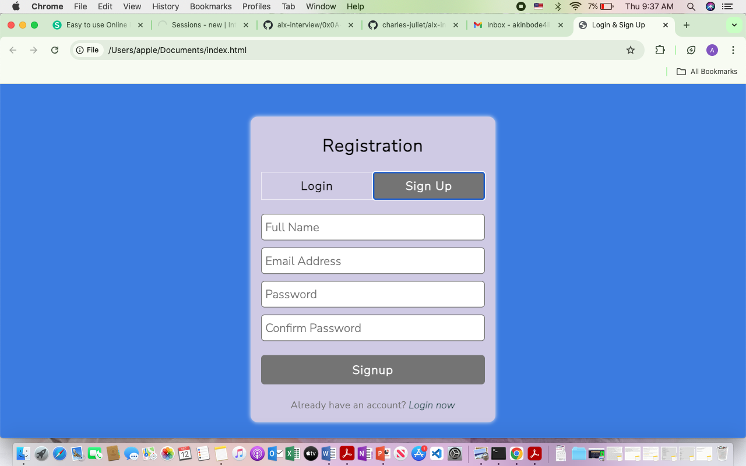

Slide 10
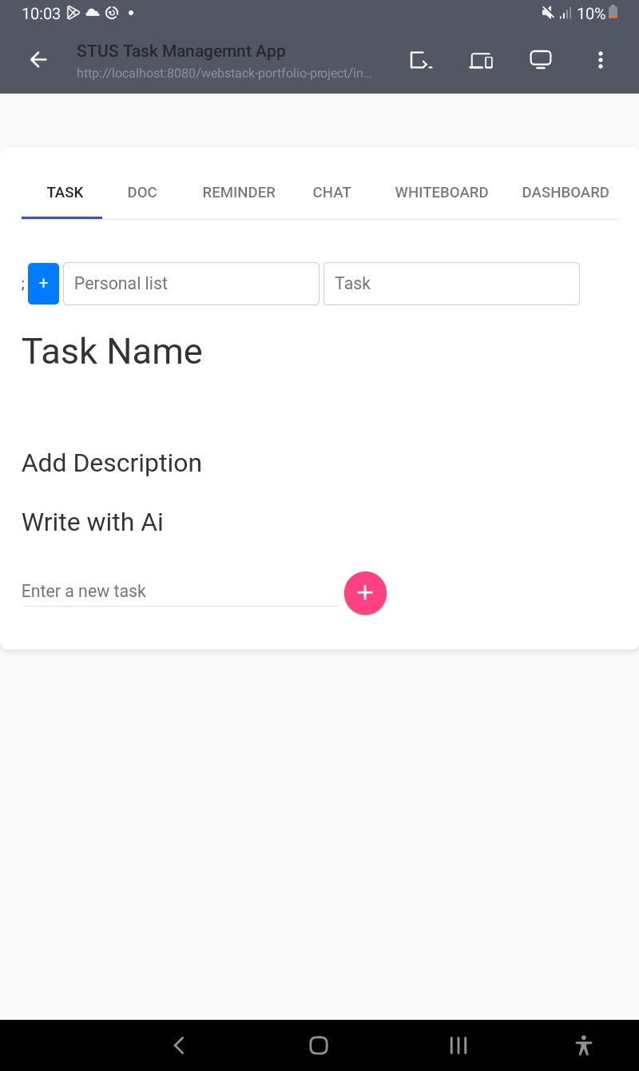

Slide 11
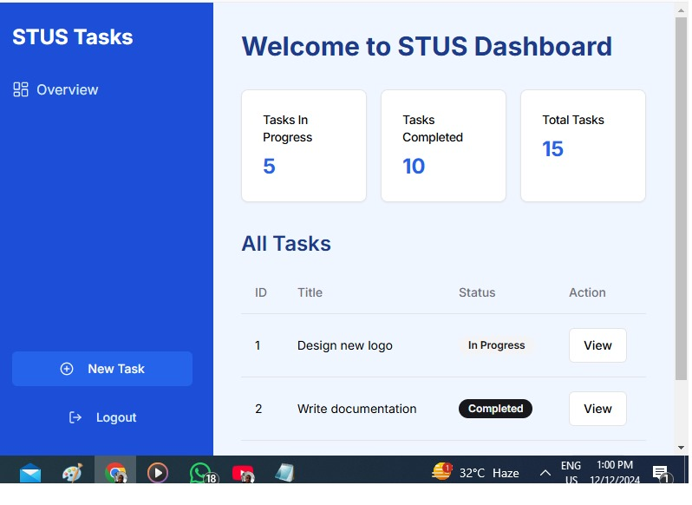

Slide 12
Schedule of Work (27 Days)
Week 1: Planning and Setup
• Day 1–2: Finalize project requirements, features, and mock-ups.
• Day 3–5: Set up the project environment (React, tools, and folder structure).
• Day 6–7: Design wireframes and mock-ups.
Week 2: Core Development
• Day 8–11: Develop authentication pages (Sign Up and Login).
• Day 12–14: Create and style the dashboard UI.
Week 3: Task Features
• Day 15–17: Implement Add, Update, Delete, and Read operations for tasks.
• Day 18–19: Add task filtering by status (Active, Completed).
Week 4: Final Features and Testing
• Day 20–22: Integrate the notification panel.
• Day 23–25: Perform cross-browser testing and debugging.
• Day 26–27: Deploy the project and prepare presentation materials.

